Slide 1
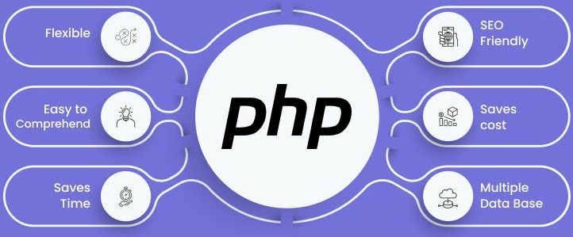

Slide 2
About today…
Functions
Creating
Passing Arguments
Returning Values
Scope of Variables

Slide 3

FUNCTIONS

Slide 4
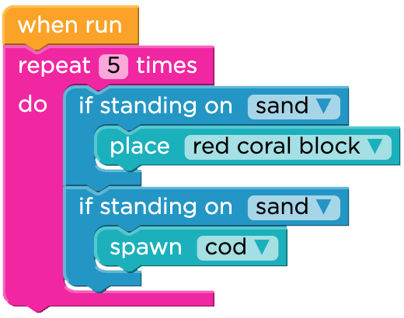
Intro to Functions
Functions in PHP are blocks of reusable code that perform specific tasks
They enhance code readability, modularity, and maintainability

Slide 5


Creating Functions
Use the function keyword followed by the function name and a pair of parentheses
Function body is enclosed within curly braces { } where you write the code
Syntax
Example

Slide 6


Function without Argument
These functions are called without passing any parameters when they are invoked
These functions are called without passing any parameters when they are invoked
Syntax
Example

Slide 7


Passing Arguments to Functions
Arguments are values passed to a function when it is called
Provide input data for the function to work with.
Syntax
Example

Slide 8


Returning Values from Functions
Can return values using the return statement
Used to exit the function and return a value to the calling code
Returned values can be stored in variables for later use or directly outputted
Syntax
Example

Slide 9


Using Returned Values
Returned values from functions can be used in various ways
Stored in Variables
Assign to a variable for further processing or storage
Example
Outputting directly
Directly outputted or used in expressions and calculations within the code
Example

Slide 10
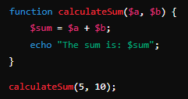
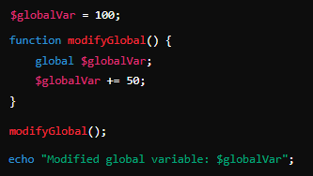
Scope of Variables
Local Variables
Declared inside a function, accessible only within that function
Example
Global Variables
Defined outside functions, accessible globally
Example

Slide 11


Slide 12

What is the purpose of functions in PHP?
Which keyword is used to access a global variable inside a function?
What are different types of functions?

Slide 13

Task 1
Create a PHP function that takes an integer and calculates its factorial
Task 2
Define a global variable with initial value 100. Create PHP function that takes an integer
and adds it to the $total
Task 3
Create two PHP functions
First should take an array of numbers and return the sum of all numbers
Second should take the same array as a parameter, call the first function and pass it that array
and then print the value returned by the first function

